Slide 1

Privacy-Preserving Contact Tracing, Syndromic Mapping and self-Assessment
Existing Solutions and Challenges
By Majunath B Marigoudar
Supervisor: Daniela Nicklas

Slide 2

Why about Contact tracing now?

Slide 3

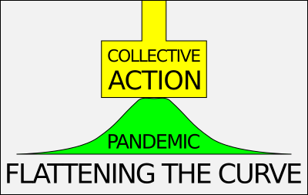
COvid-19!!!
Wuhan China-December 31, 2019
Over 6000 million affected and 6 million death
Highly contagious nature
Uncontrollably exponential rise
Preliminary Solution: Social distancing
Slower vaccine development
Digital approach : Contact tracing Apps
Ref: https://www.worldometers.info/coronavirus/ Accessed: Aug. 27, 2022

Slide 4


So, Why not?
To save humanity!
Better to be prepared for the future
Good to learn from the past (availability of huge data source)
Social distancing: Best precaution for any infectious diseases
Longer waiting for medical solutions (i.e. Vaccine)
A collective approach is better

Slide 5
Agenda
What is a Contact tracing app?
Different Architectures
Existing Solutions and Challenges
Privacy concerns and threats
Different types of security attacks
What do you think?

Slide 6

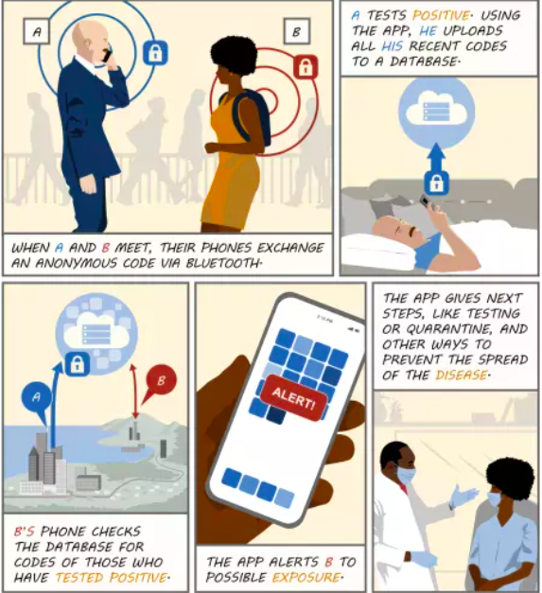
Contact tracing
Special ID is exchanged (Bluetooth)
If infected
Volunteer reporting
Data updated by health department
GPS based-
Provides live details of close proximity
Two main designs
Centralized
Decentralized
Ref: https://www.gao.gov/blog/tech-behind-covid-19-contact-tracing

Slide 7
Centralized Architecture
Fig. 1. The centralized architecture of Covid Tracing Apps
Ref: B. Sowmiya, V. Abhijith, S. Sudersan, R. Sakthi Jaya Sundar, M. Thangavel, and P. Varalakshmi, “A survey on security and privacy issues in contact tracing application of covid-19,” SN computer science, vol. 2, no. 3, pp. 1–11, 2021.

Slide 8
DeCentralized Architecture
Fig. 2. The decentralized architecture of Covid Tracing Apps
Ref: B. Sowmiya, V. Abhijith, S. Sudersan, R. Sakthi Jaya Sundar, M. Thangavel, and P. Varalakshmi, “A survey on security and privacy issues in contact tracing application of covid-19,” SN computer science, vol. 2, no. 3, pp. 1–11, 2021.

Slide 9
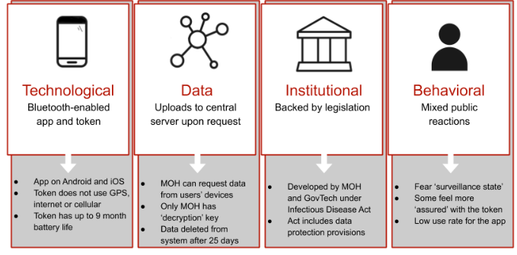

Existing solutions
Singapore’s TraceTogether
(NUMi, MoH, IDi,K)
MoH stores (NUMi,IDi) pair
2 user within bluetooth range
exchanges Encapsulated ID (TIDs)
If infected —>MoH gets info
—> decrypts(TIDi,K) and informs NUMj
No GPS, Centralized
Access to location, camera, storage,
WiFi, Bluetooth, and media
Ref: Q. Tang, “Privacy-preserving contact tracing: current solutions and open questions,” arXiv preprint arXiv:2004.06818, 2020.

Slide 10
Existing solutions cont…
India’s Aarogya Setu- Mandatory by Govt
Flow events
Registration, Self-assessment, Use, Contact, Testing, Contact tracing and containment
Using its database and algorithms - locate and notify nearby cellphones
Not open source, Govt handles database
Both bluetooth and GPS(to find and allow user mov.), Centralized
Location access(Not uploaded to the server continuously) and Bio data
Others: CovidWise(US), CovidRadar(Netherland), NHS Covid-19(UK)
(
Ref: 1)R. Gupta, M. Bedi, P. Goyal, S. Wadhera, and V. Verma, “Analysis of covid-19 tracking tool in india: case study of aarogya setu mobile application,” Digital Government: Research and Practice, vol. 1, no. 4, pp. 1–8, 2020.

Slide 11

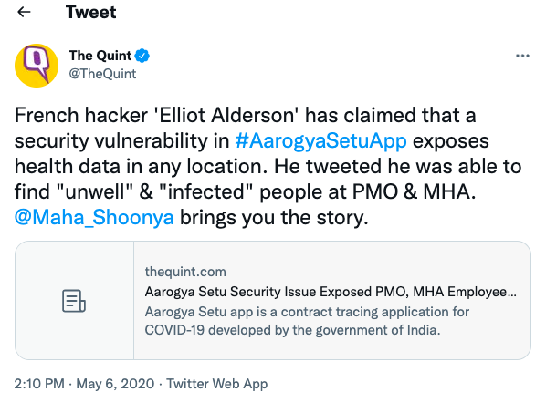
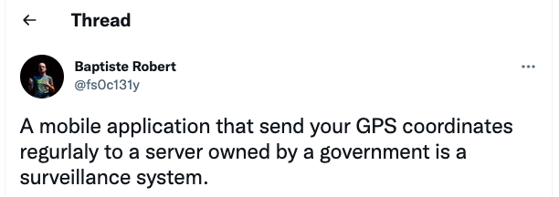

Privacy concerns and threats
No System is threat proof!!
Ref: 1) https://www.gosecure.net/blog/2020/04/07/privacy-concerns 2) https://twitter.com/fs0c131y/status/1258679680888188928
3) https://week99er.com/new/why-gps-technology-is-a-curse-and-a-boon-that-also-raises-privacy-issues/

Slide 12
Privacy concerns and threats cont..
Privacy Concerns
Information Collection and destruction
Transparency
Data Storage
Location Privacy
Security Threats
Denial of Service
Phishing Attacks
Tracking Wireless Device
Playback Attack
Man-in-the-middle attack
Ref: 1)“Tracetogether.” [Online]. Available: https://www.tracetogether.gov.sg/
2) S. Bassi and A. Chaudhary, “Cloud computing data security–background and benefits,” International Journal of Computer Science & Communi- cation, vol. 6, no. 1, pp. 34–40, 2015.

Slide 13
Conclusion
So how to make a fail proof approach ? What about,
Contact tracing is the vital solution to containing the spread.
Further attention for more reliable and secure and be ready
Using more secure data encryption methods implementation,
Bluetooth low energy technology,
secure data storage (preferably cloud storage) for protecting the data.

Slide 14

Security attacks

Slide 15


